Slide 1
COMP4925 , sub-project 1
Norman Lim
Daniel Lin
Manveer Bhangu

Slide 2

The San Francisco Salaries Dataset
San Francisco GDP increased by 155 Billion within the span of 13 years, 2001-2014.
Averages out to an increase of approximately 12 Billion each year
Dataset focuses on the Peak years of 2011 to 2014.

Slide 3
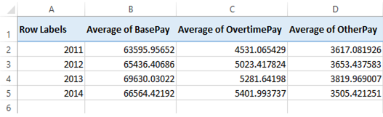
Hypothesis 1
The increase in GDP should definitely reflect an increase in salary overall. We wanted to see if the apparent increase of the salary is a significant amount.
*created with an excel PivotTable

Slide 4
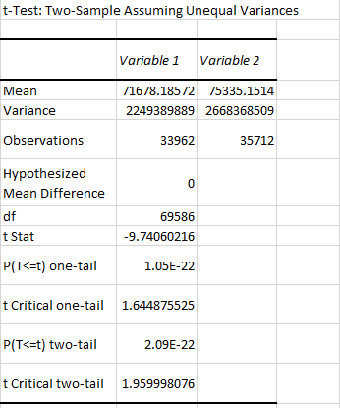
Hypothesis 1 Conclusions
Using t-Test (unequal variance): Two Sample for Means, we examined total salary from 2011 and 2014 to see if there are any significant difference over 4 years.
We found that there is a significant probable difference between the year 2011 and 2014 in terms of salary.

Slide 5
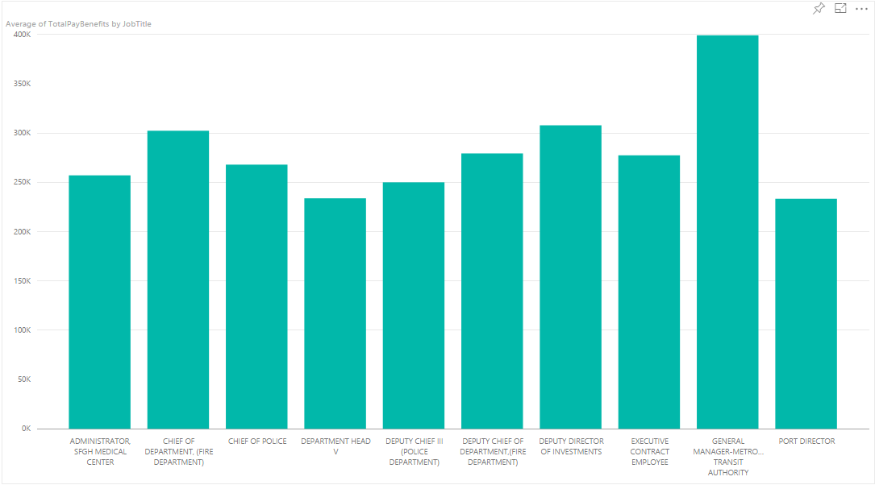
Hypothesis 2
After playing around with the data, we managed to find the highest paid occupations in San Francisco in 2011.
Hypothesis:
Those occupations will most likely see an increase in salary.

Slide 6
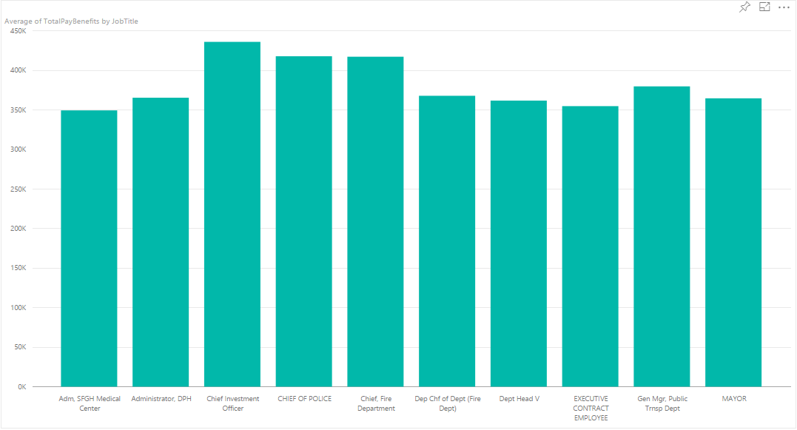
*most highest paying jobs in 2011 were slightly below the 250k range.
*almost all highest paying jobs in 2014 are over the 350k range.

Slide 7
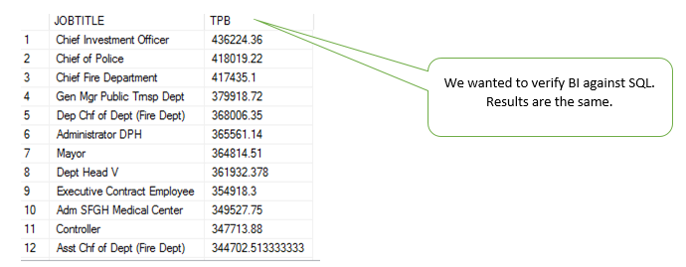
This was because PowerBI is a unstructured learning, and we wanted to actually understand the data? lol

Slide 8
List of highest paying jobs in 2011
- Administrator, SFGH medical center
- Chief of department(fire department)
- Chief of police
- Department head V
- Deputy chief III (police department)
- Deputy chief of department (fire department)
- Deputy director of investments
- Executive contract employee
- General manager metro transit authority
- Port director
List of highest paying jobs in 2014
- Administrator San Francisco General Hospital Medical Center
- Chief of Department (Fire Department)
- Chief of Police
- Department Head
- Deputy Chief
- General Manager of Transit Authority
- Port Director
- Executive Contract Employee
- Mayor
- Chief Investment Officer

Slide 9
Also, a recurring trend shows that there is always someone with the title “Investor” who is always present in the Top 10 salaries.

